Slide 1
Negative rate of change from a graph
Graphical representations of linear equations

Slide 2
how to use Oak lessons

Slide 3
I can calculate the negative rate of change (gradient) from a graph.

Slide 4
The gradient is a measure of how steep a line is. It is calculated by finding the rate of change in the y-direction with respect to the positive x-direction.
The absolute value of a number is its distance from zero. E.g. 5 and (−5) are both 5 away from zero and so both have an absolute value of 5.
Two lines are parallel if they are straight lines that are always the same (non-zero) distance apart.

Slide 5

Negative rate of change from a graph
Calculating negative gradients from graphs
Calculating gradient from any graph

Slide 6
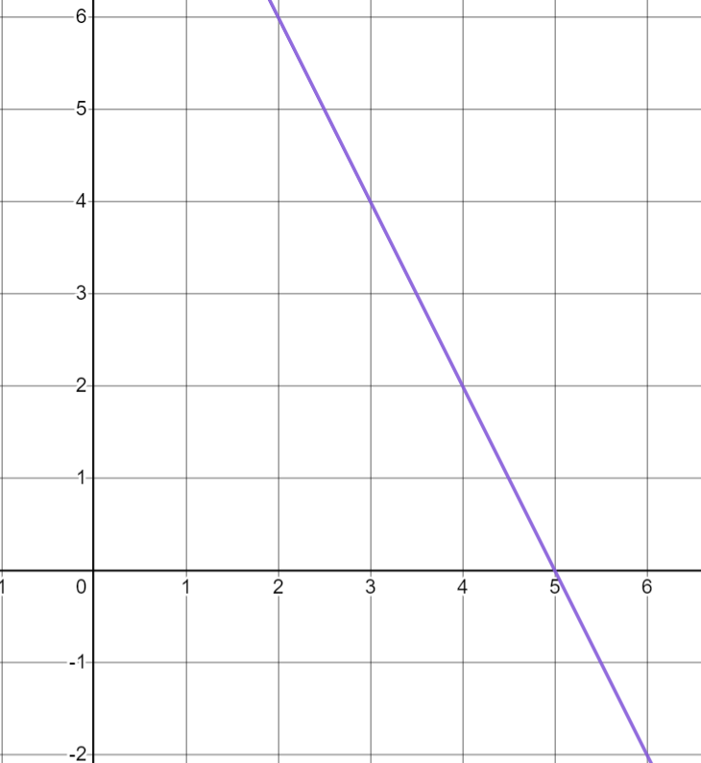


Calculating negative gradients from graphs
Gradient describes the change in y for an increase of 1 in the positive x-direction.
The gradient of this line is 2
+2
Izzy
+1
Is Izzy correct?
No, she has measured 1 in the negative x-direction not the positive x-direction.

Slide 7
Calculating negative gradients from graphs
Gradient describes the change in y for an increase of 1 in the positive x-direction
But if I move in the positive x-direction, my vertical line never reaches my graph.
Izzy
+1
What could Izzy do?
Once she has moved 1 in the positive x-direction, her vertical line needs to be drawn downwards.

Slide 8
Calculating negative gradients from graphs
Change in x | Change in y
1 | −2
+1
The gradient of this line is negative 2
−2
If y decreases as the graph moves to the right (positive x-direction) then the gradient will be negative.

Slide 9
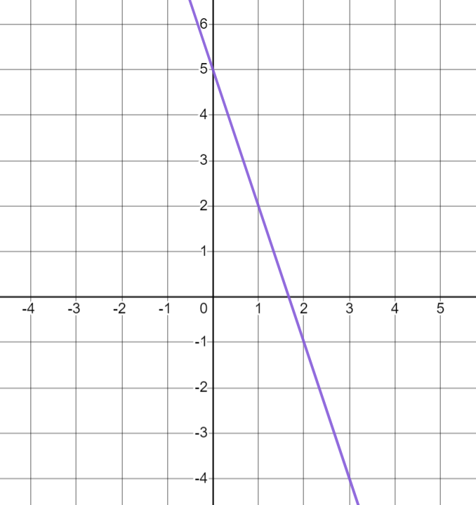
Calculating negative gradients from graphs
We can use this method to calculate the gradient of any line.
Change in x | Change in y
1 | −3
+1
The gradient of this line is −3
−3

Slide 10
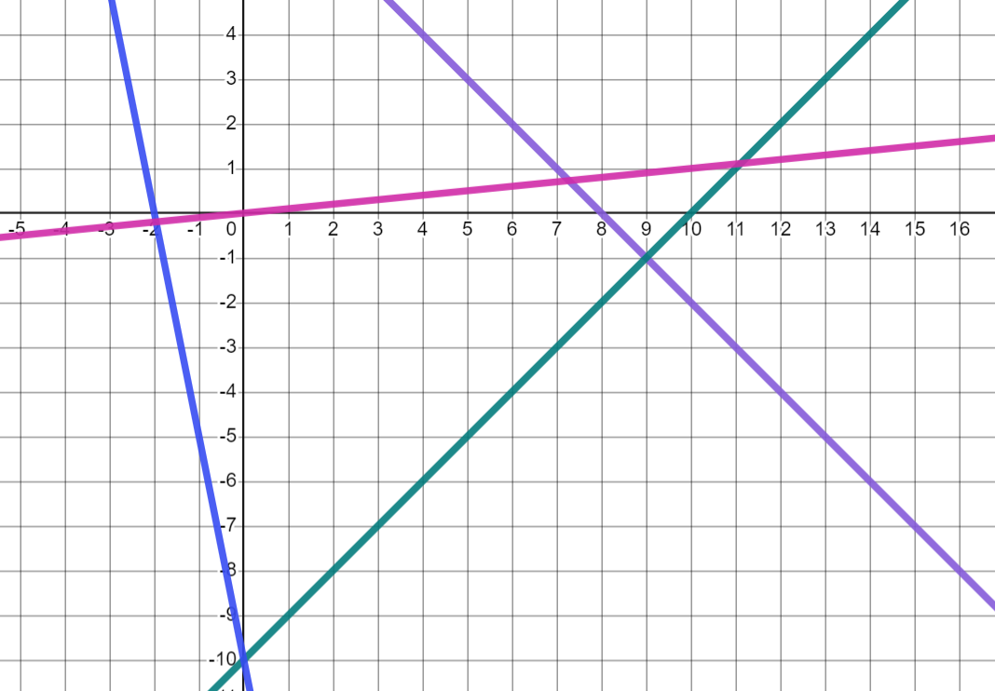
Calculating negative gradients from graphs
Which of these graphs have negative gradients?
B
C
D
B- blue graph
A
C- purple graph
A and D ( pink and green) graphs have positive gradients.

Slide 11


Calculating negative gradients from graphs
Which of these tables of values will form graphs with a negative gradient when plotted?
a
x | 0 | 1 | 2 | 3 | 4
y | 7 | 9 | 11 | 13 | 15
b
x | 7 | 8 | 9 | 10 | 11
y | 8 | 7 | 6 | 5 | 4
The values of y are decreasing as x is increasing.
c
x | −9 | −8 | −7 | −6 | −5
y | −2 | −4 | −6 | −8 | −10
d
x | −2 | −1 | 0 | 1 | 2
y | −30 | −25 | −20 | −15 | −10

Slide 12
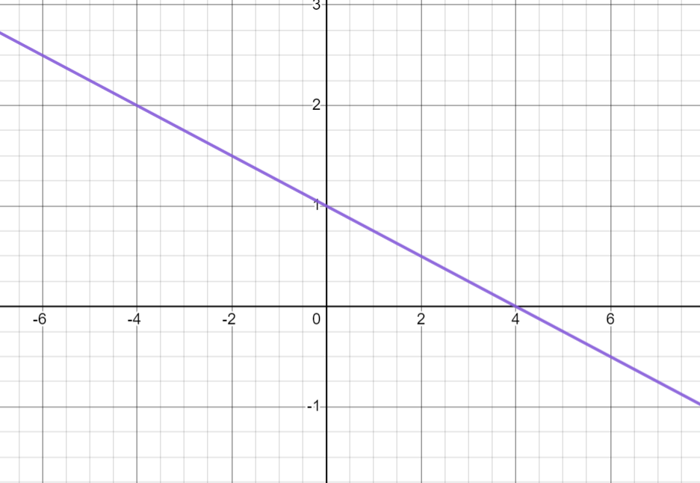


Calculating negative gradients from graphs
Andeep has tried to measure the gradient of this line.
+4
What has he done well?
Where has he made a mistake?
−1
He has moved in the positive x-direction.
He knows y is decreasing so gradient is negative.
He has noticed the scale on the x-axis.
Change in x | Change in y
4 | −1
He has filled in his table correctly.
He needs the change in x to be 1 so he needs to divide both values by 4 to get a gradient of
The gradient is −4
Andeep

Slide 13

Calculating negative gradients from graphs
+4
So the gradient is
−1
Andeep
Change in x | Change in y
4 | −1
÷4
÷4
1

Slide 14
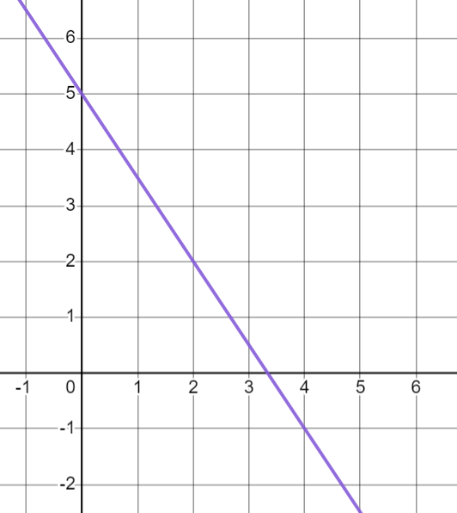
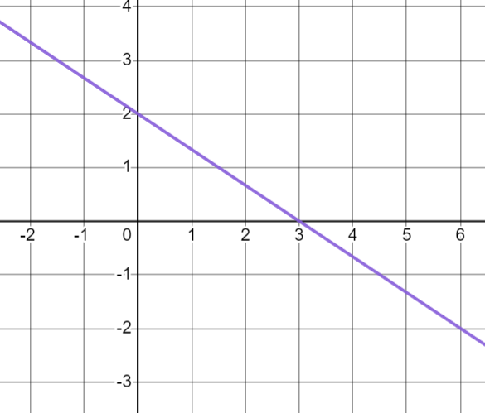


Calculating negative gradients from graphs
Calculate the gradient of this line.
Calculate the gradient of this line.
+2
+3
−3
−2
gradient =
gradient =
Change in x | Change in y
2 | −3
1
Change in x | Change in y
3 | −2
1
÷2
÷3

Slide 15
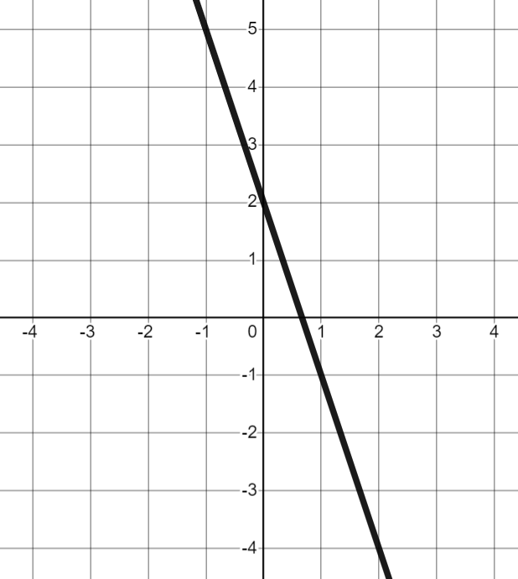
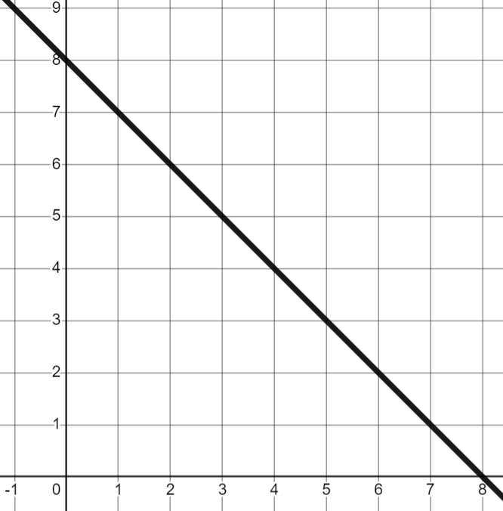
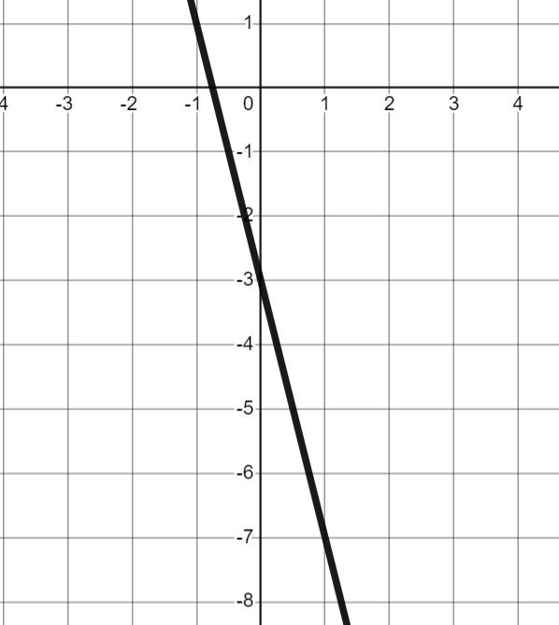
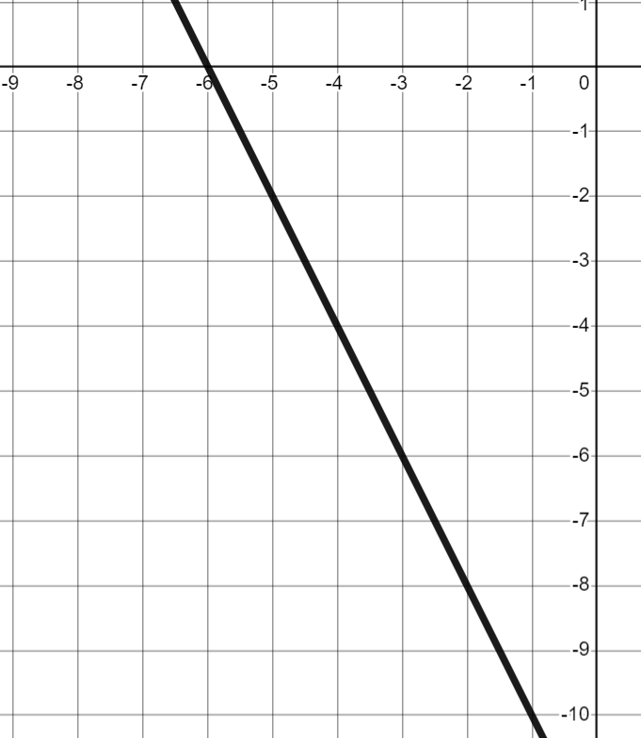
Calculating negative gradients from graphs
Find the gradient of each line.
a) | b) | c) | d)

Slide 16
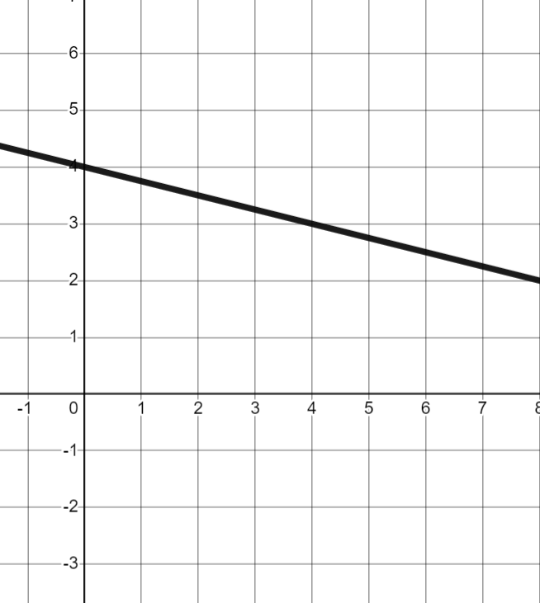
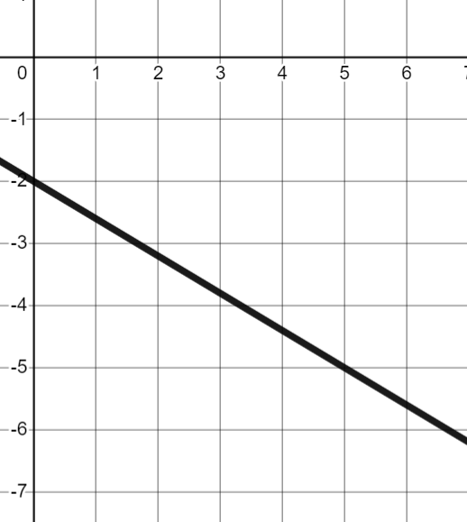
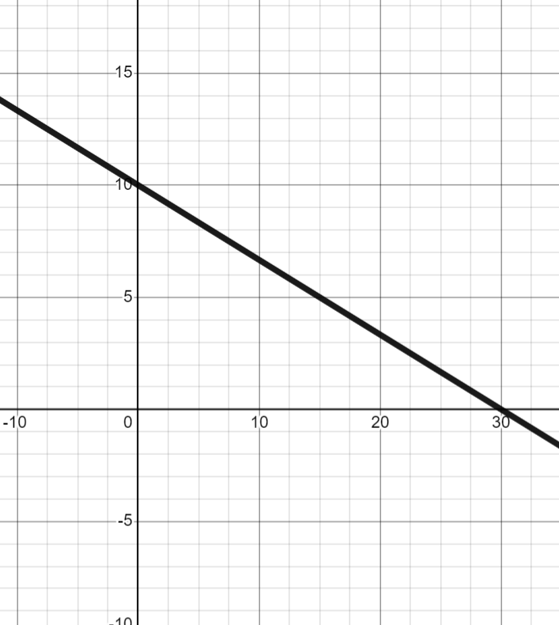
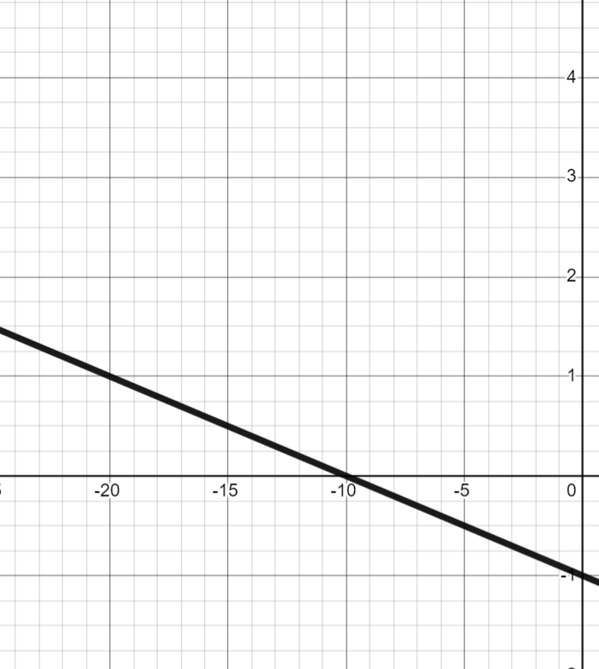
Calculating negative gradients from graphs
Find the gradient of each line.
e) | f) | g) | h)

Slide 17
Calculating negative gradients from graphs
Find the gradient of each line.
a) | b) | c) | d)
−3
−1
−4
−2

Slide 18


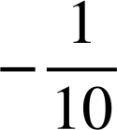
Calculating negative gradients from graphs
Find the gradient of each line.
e) | f) | g) | h)
4 | −1
1
5 | −3
1
30 | −10
1
10 | −1
1

Slide 19
Negative rate of change from a graph
Calculating negative gradients from graphs
Calculating gradient from any graph

Slide 20
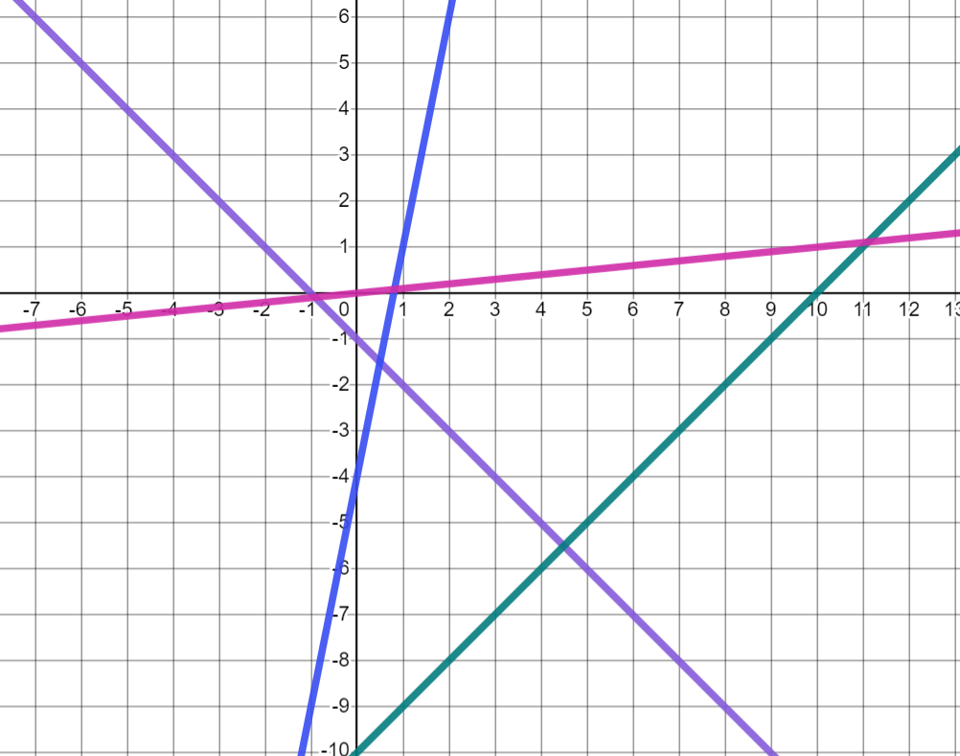

Calculating gradient from any graph
Knowing the gradient of a graph can give us information about what the graph looks like.
Four pupils have each drawn a graph on the axis below:
The gradient of my graph is −1
C
B
D
Jun
A
Which graph is Jun’s?
B (purple) because it is the only graph with a negative gradient.

Slide 21

Calculating gradient from any graph
Lines with positive gradients increase as the graph moves to the right. Lines with negative gradients, decrease as the graph moves to the right.
So I don’t need to worry about negative numbers. I can calculate the gradient using the absolute values and decide if it’s positive or negative from the shape of the graph.
What do you think Aisha means by this?
Do you agree?
Jun
Aisha

Slide 22
Calculating gradient from any graph
The absolute value of a number is its distance from zero. So 3 and −3 both have an absolute value of 3 as they are 3 away from zero.
So I don’t need to worry about negative numbers. I can calculate the gradient using the absolute values and decide if it’s positive or negative from the shape of the graph
Aisha means she can:
Find the change in x and change in y as positive numbers.
Find the gradient from the positive values.
Look at the graph to see if it is increasing or decreasing as the graph moves right to decide if the gradient is positive or negative.
Aisha

Slide 23
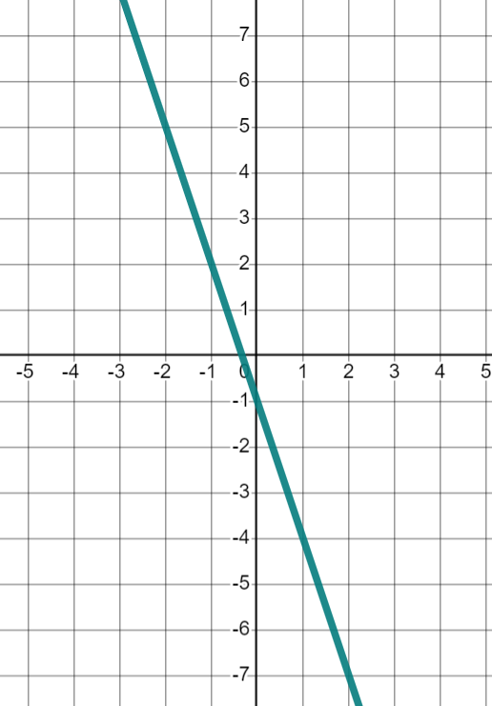
Calculating gradient from any graph
Change in x | Change in y
1 | 3
I can see the graph has negative gradient so the gradient must be −3
3
Aisha’s method does work.
1
Knowing whether your gradient is supposed to be positive or negative can help you check your answers.
Can you see any difficulties with Aisha’s method?

Slide 24
Calculating gradient from any graph
Can you see any difficulties with Aisha’s method?
She may get her x- and y-directions confused especially with fractional gradients.
3
1
She may forget to write the gradient as negative and then her working does not support a negative gradient.
This might not work as well if she is not given the graph and needs to work out the gradient from coordinates or other information.

Slide 25
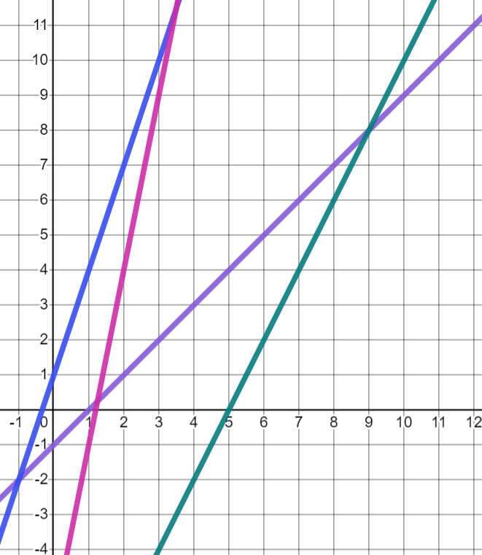
Calculating gradient from any graph
As well as knowing whether the graph is increasing or decreasing as it moves right, knowing the gradient can tell us other features of the graph.
Which line is steepest?
B (Pink): gradient = 5
B
A
C
A (Blue): gradient = 3
D
D (Green): gradient = 2
C (Purple): gradient = 1
What do you notice about the gradient of steeper lines?
The steeper lines had larger gradients.

Slide 26
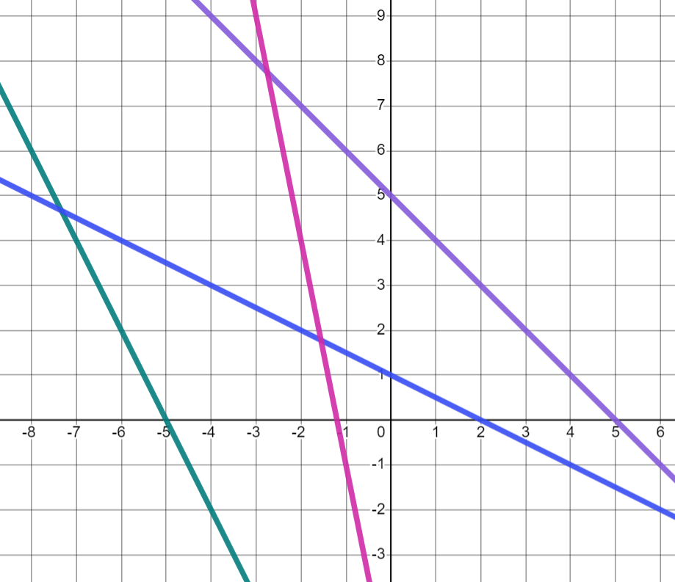

Calculating gradient from any graph
These graphs have negative gradients. Which is the steepest this time?
C (Pink): gradient = −5
A (Green): gradient = −2
C
D
D (Green): gradient = −1
B
B (Blue): gradient =
A
With negative gradients, steeper lines have smaller values for the gradient.
(−5＜−2)

Slide 27
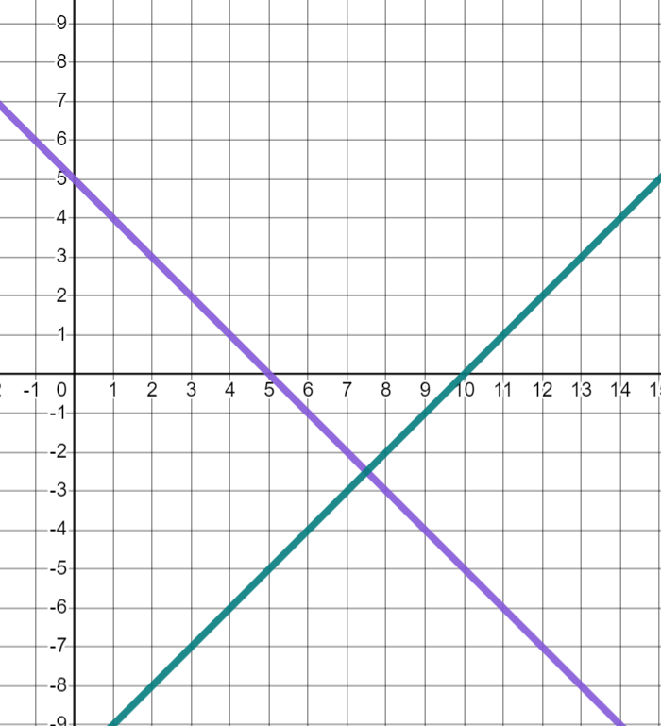
Calculating gradient from any graph
Which is steeper: a graph with gradient 1 or a graph with gradient −1?
A (Purple): gradient = −1
B (Green): gradient = 1
B
Both graphs are equally steep but are reflections of each other.
A
If you calculate the absolute value of the gradient then the larger the absolute value the steeper the gradient.
So a graph of gradient −2 would look steeper than a graph with gradient 1

Slide 28

Calculating gradient from any graph
Put these gradients in order of steepness, starting with the steepest.
steepest
gradient = −1
gradient = −1
gradient =
gradient =
gradient =
gradient =
gradient =
gradient =

Slide 29
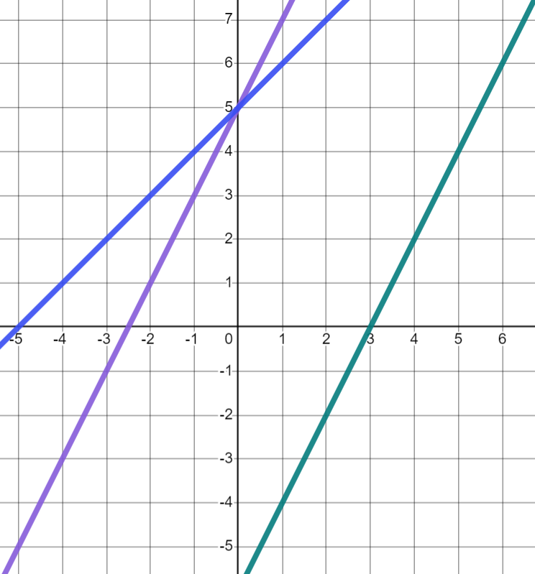
Calculating gradient from any graph
Lines are parallel if they are always the same distance apart.
Which two lines are parallel? How can you tell?
A and C are parallel
B
They are always the same distance apart.
C
What are the gradients of these lines?
A
A and C both have gradients of 2
B has a gradient of 1

Slide 30
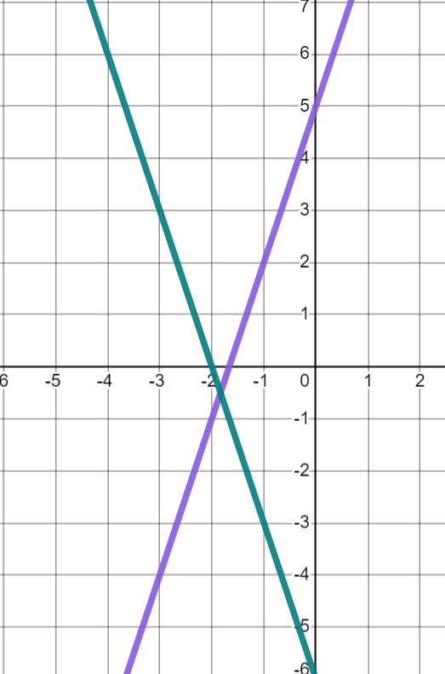
Calculating gradient from any graph
A line with gradient 3 and a line with gradient −3 have equal steepness, will they be parallel?
B
Izzy
No. One has a positive gradient so is increasing as the graph moves right and the other has a negative gradient so is decreasing as the graph moves right.
A
Parallel lines will have the same gradient.

Slide 31
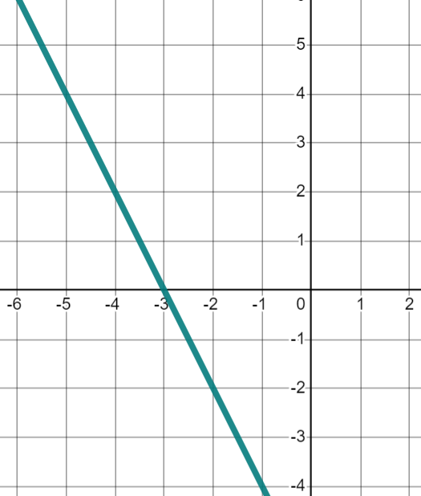
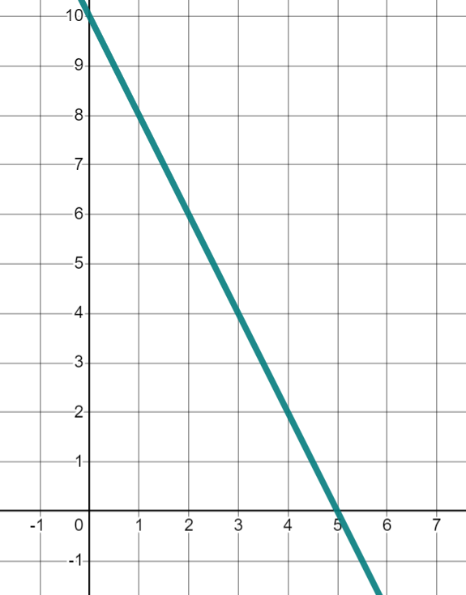
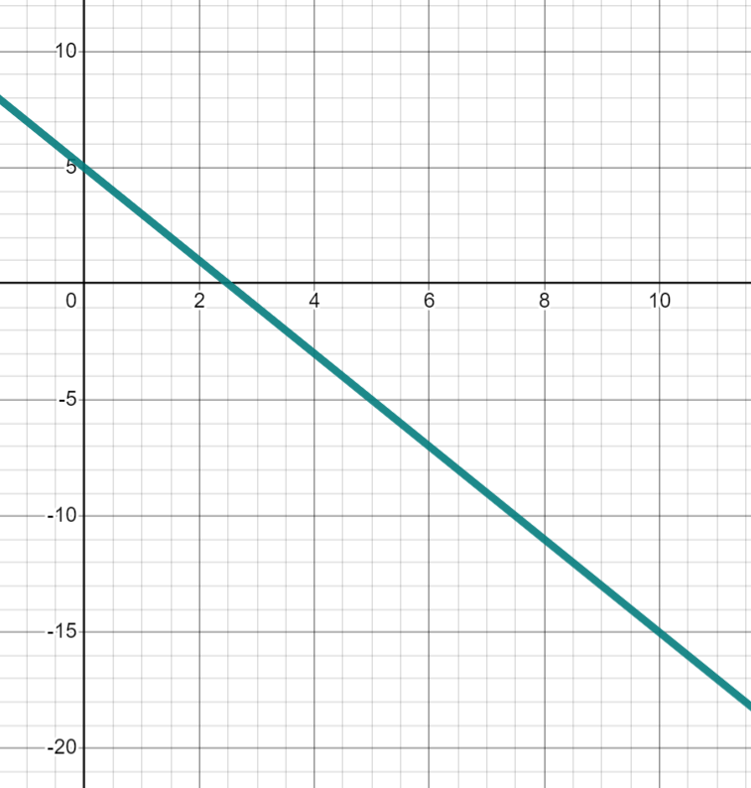
Calculating gradient from any graph
We can calculate gradients to see if lines would be parallel when plotted on the same axis.
+10
+1
+1
−2
−2
−20
gradient = −2
gradient = −2
Change in x | Change in y
10 | −20
1
All three lines are parallel, just drawn on different scaled axes.
−2

Slide 32
Calculating gradient from any graph
A line with a positive gradient cannot be parallel to a line with a negative gradient.
Positive gradients are steeper than negative gradients.
Lines have to have the exact same gradient to be parallel.

Slide 33
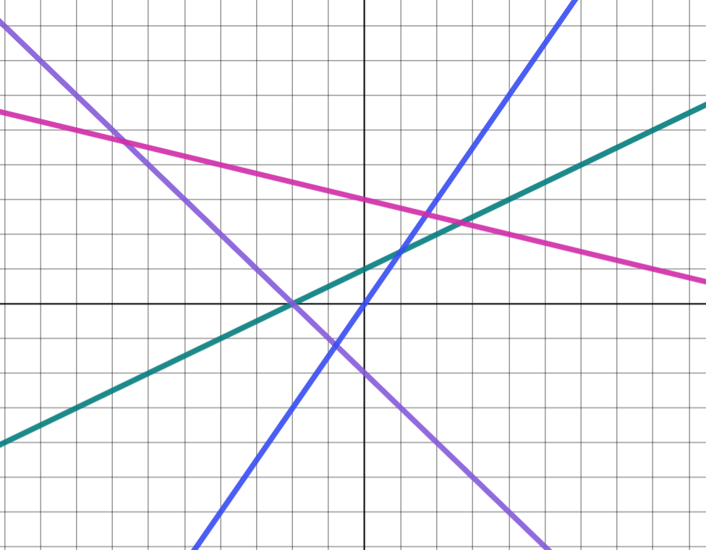
Calculating gradient from any graph
Four lines have been drawn on a set of axes with unknown scale. Match each line to its gradient.
D
gradient = 1
gradient = 3
gradient = −2
gradient =
C
B
A

Slide 34
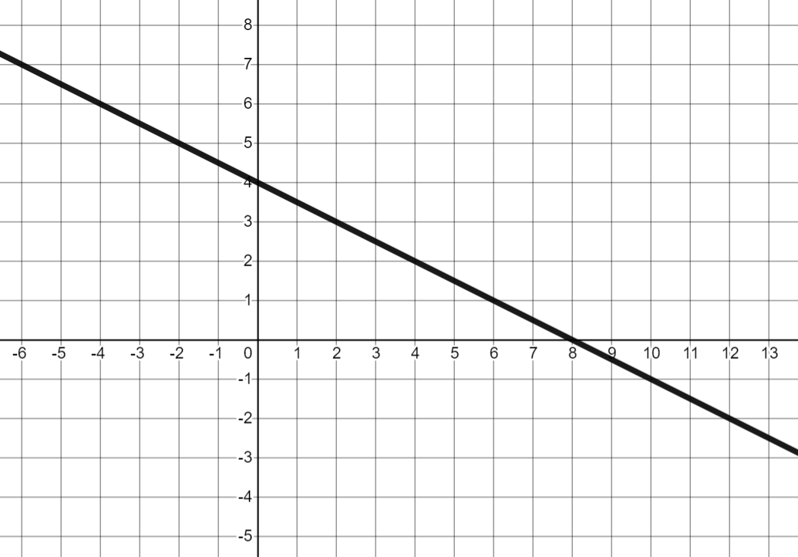
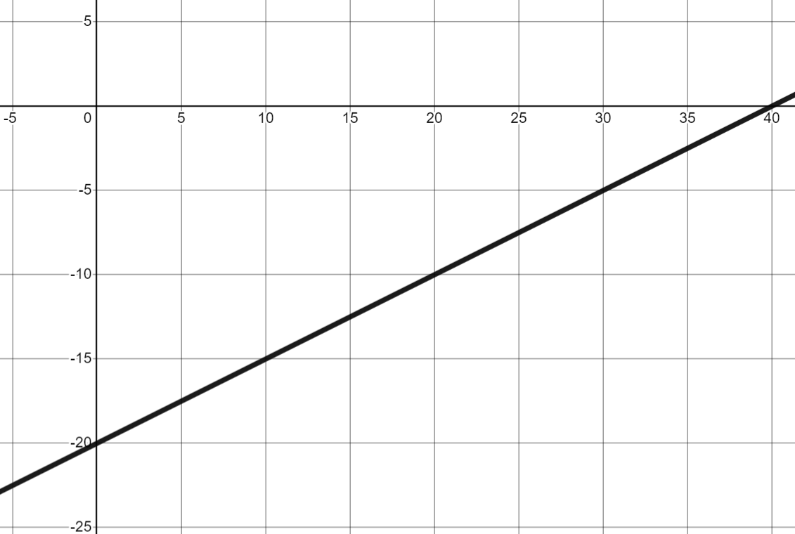
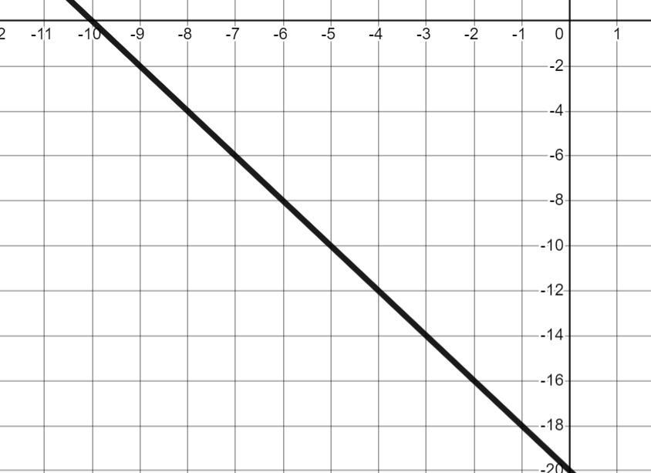
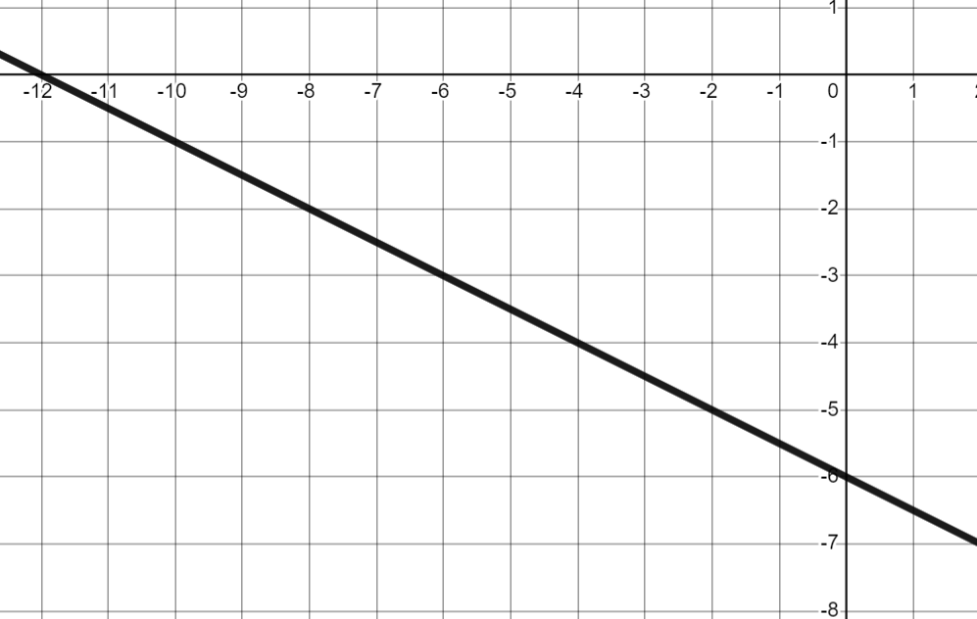
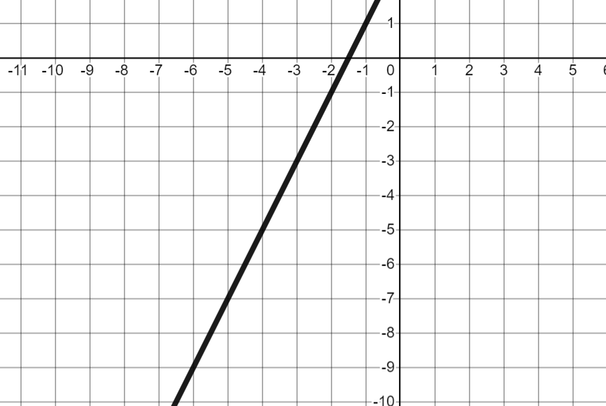
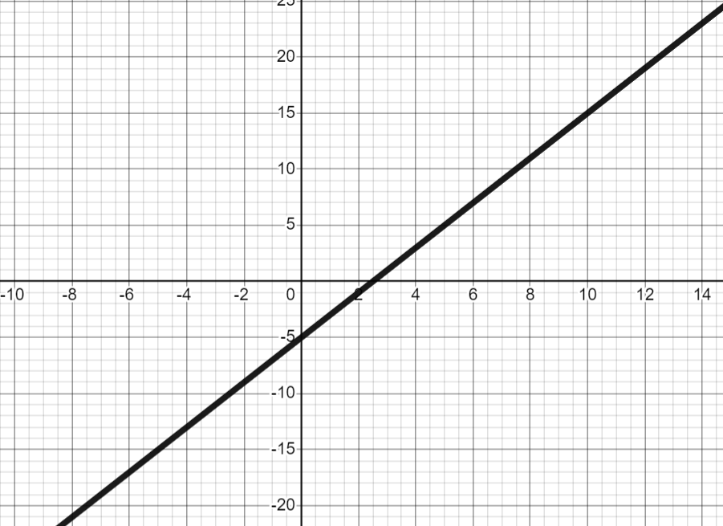
Calculating gradient from any graph
2) Which lines are parallel? Calculate the gradients and match any parallel lines.
A
B
C
D
E
F

Slide 35
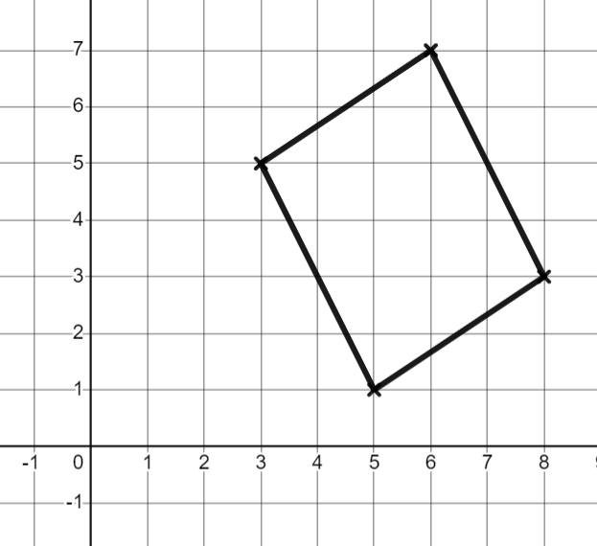
Calculating gradient from any graph
3) Andeep is trying to prove this shape is a parallelogram
Finish off his working out.
Opposite sides in a parallelogram are parallel. Therefore they must have the same gradient.
−2
−2
Andeep
The left and right sides are parallel…

Slide 36
Calculating gradient from any graph
Four lines have been drawn on a set of axes with unknown scale. Match each line to its gradient.
B (green line)
D
gradient = 1
gradient = 3
gradient = −2
gradient =
C
A (blue line)
D (purple line)
B
C (pink line)
A

Slide 37

Calculating gradient from any graph
2) Which lines are parallel? Calculate the gradients and match any parallel lines.
A
B
C
A and D are parallel
E and F are parallel
gradient =
gradient =
gradient = −2
D
E
F
gradient =
gradient = 2
gradient = 2

Slide 38

Calculating gradient from any graph
3) Andeep is trying to prove this shape is a parallelogram
Finish off his working out.
Opposite sides in a parallelogram are parallel. Therefore they must have the same gradient.
+2
+3
Andeep
The left and right sides are parallel…
+2
+3
Change in x | Change in y
3 | 2
1
The top and bottom both have a gradient of so are parallel.

Slide 39
Negative rate of change from a graph
If y decreases as x increases, the gradient is negative.
Negative gradients can be calculated by finding the amount y decreases when x increases by 1
Graphs that have the same gradient are parallel.
The absolute value of the gradient lets you compare the steepness of positive and negative gradients.

Slide 40

© Oak National Academy 2023.
Produced in partnership with Mathematics in Education and Industry.
Licensed on the Open Government Licence v3.0, except where otherwise stated. See Oak terms and conditions.

